Slide 1
FSAD – CS 05
Course : – REST Api GRaphQL gRPC – Module 05

Slide 2
Agenda - DEMOS
1) Swagger
3) Recap – React Sending Request to RESTAPI
4) Web Hook – Basic
5) WebSocket – Basic
6) Graphics QL
7) gRPC – PUSHED to Post Mid-Sem

Slide 3
Swagger
What are all the operations that your API supports?
What are your API’s parameters and what does it return?
Does your API need some authorization?
And even fun things like terms, contact information and license to use the API.

Slide 4
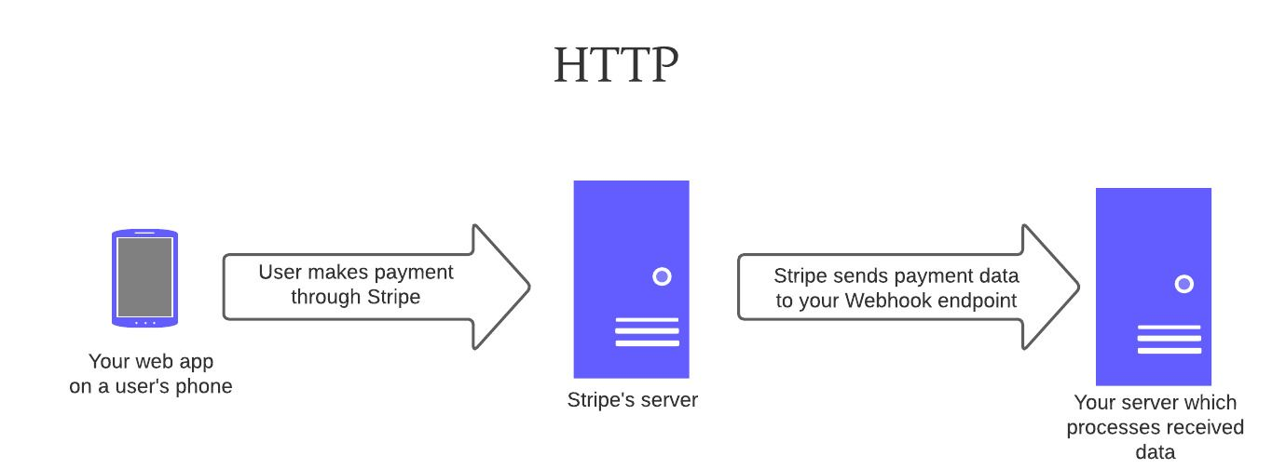
Webhooks
An Event Triggered HTTP request
HTTP callback action triggered by an event in a server
Uses HTTP as protocol

Slide 5
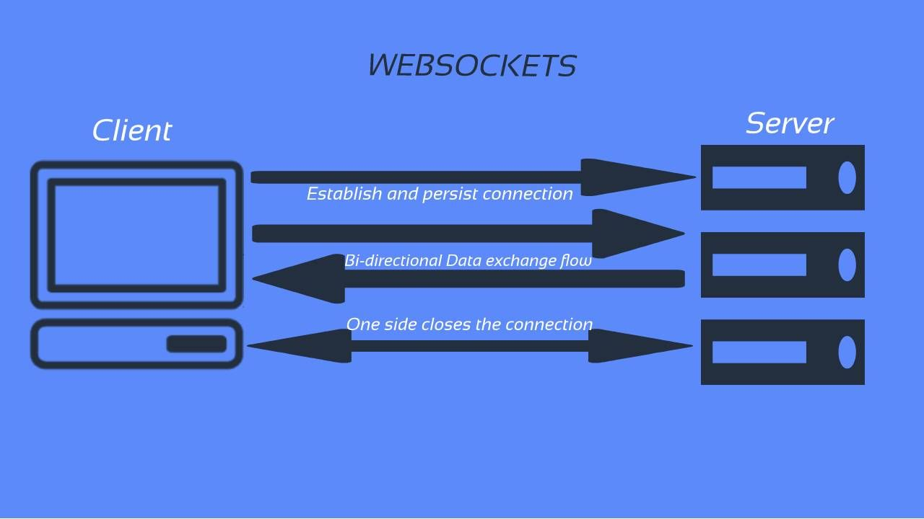
WebSocket
It establishes 2 way persistent com channel
WebSockets can be very beneficial when working on
low-latency server-client data streaming applications.
Is a Protocol by itself unlike Webhooks which uses HTTP
Best example of WebSockets is in chat applications like WhatsApp

Slide 6
GraphQL
GraphQL is a query language for the API
A server-side runtime for executing queries using a type system you define for your data.
Was initially developed by FACEBOOK
Was open-sourced in 2015 and has since been implemented in a variety of programming languages

Slide 7
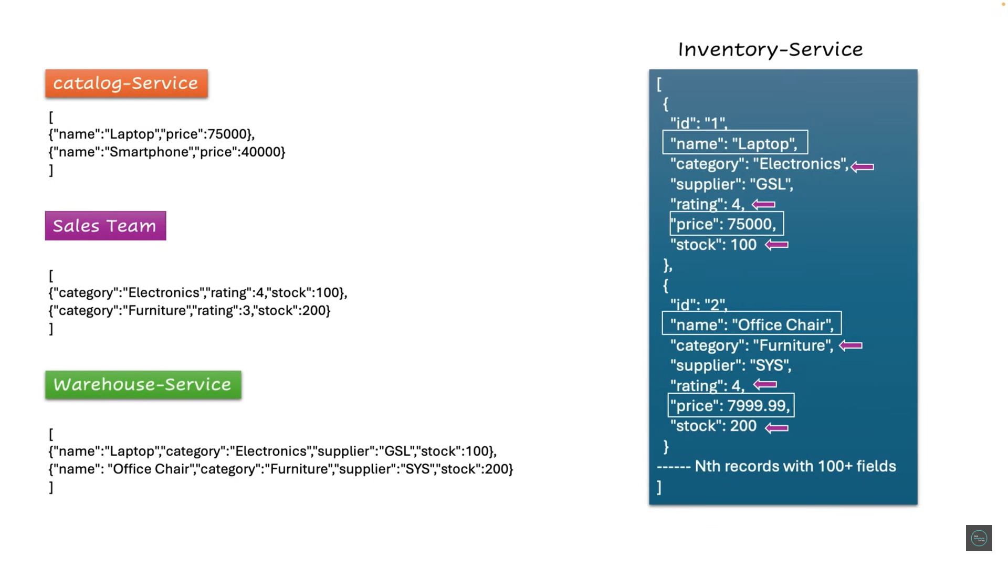
GraphQL

Slide 8
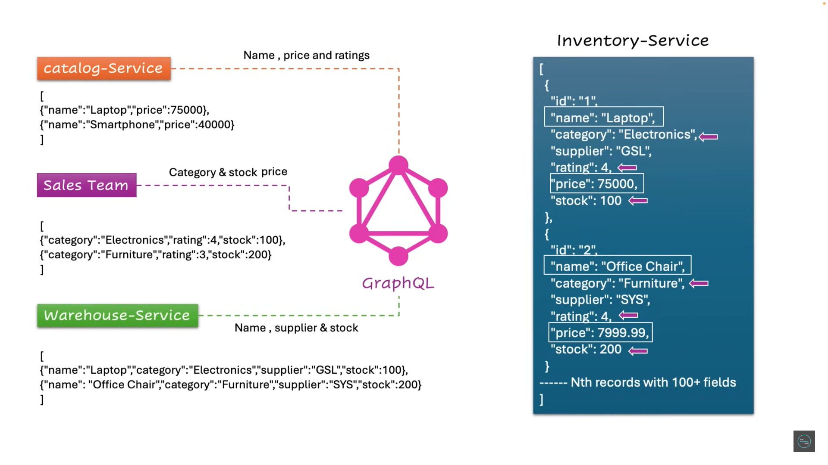
GraphQL

Slide 9
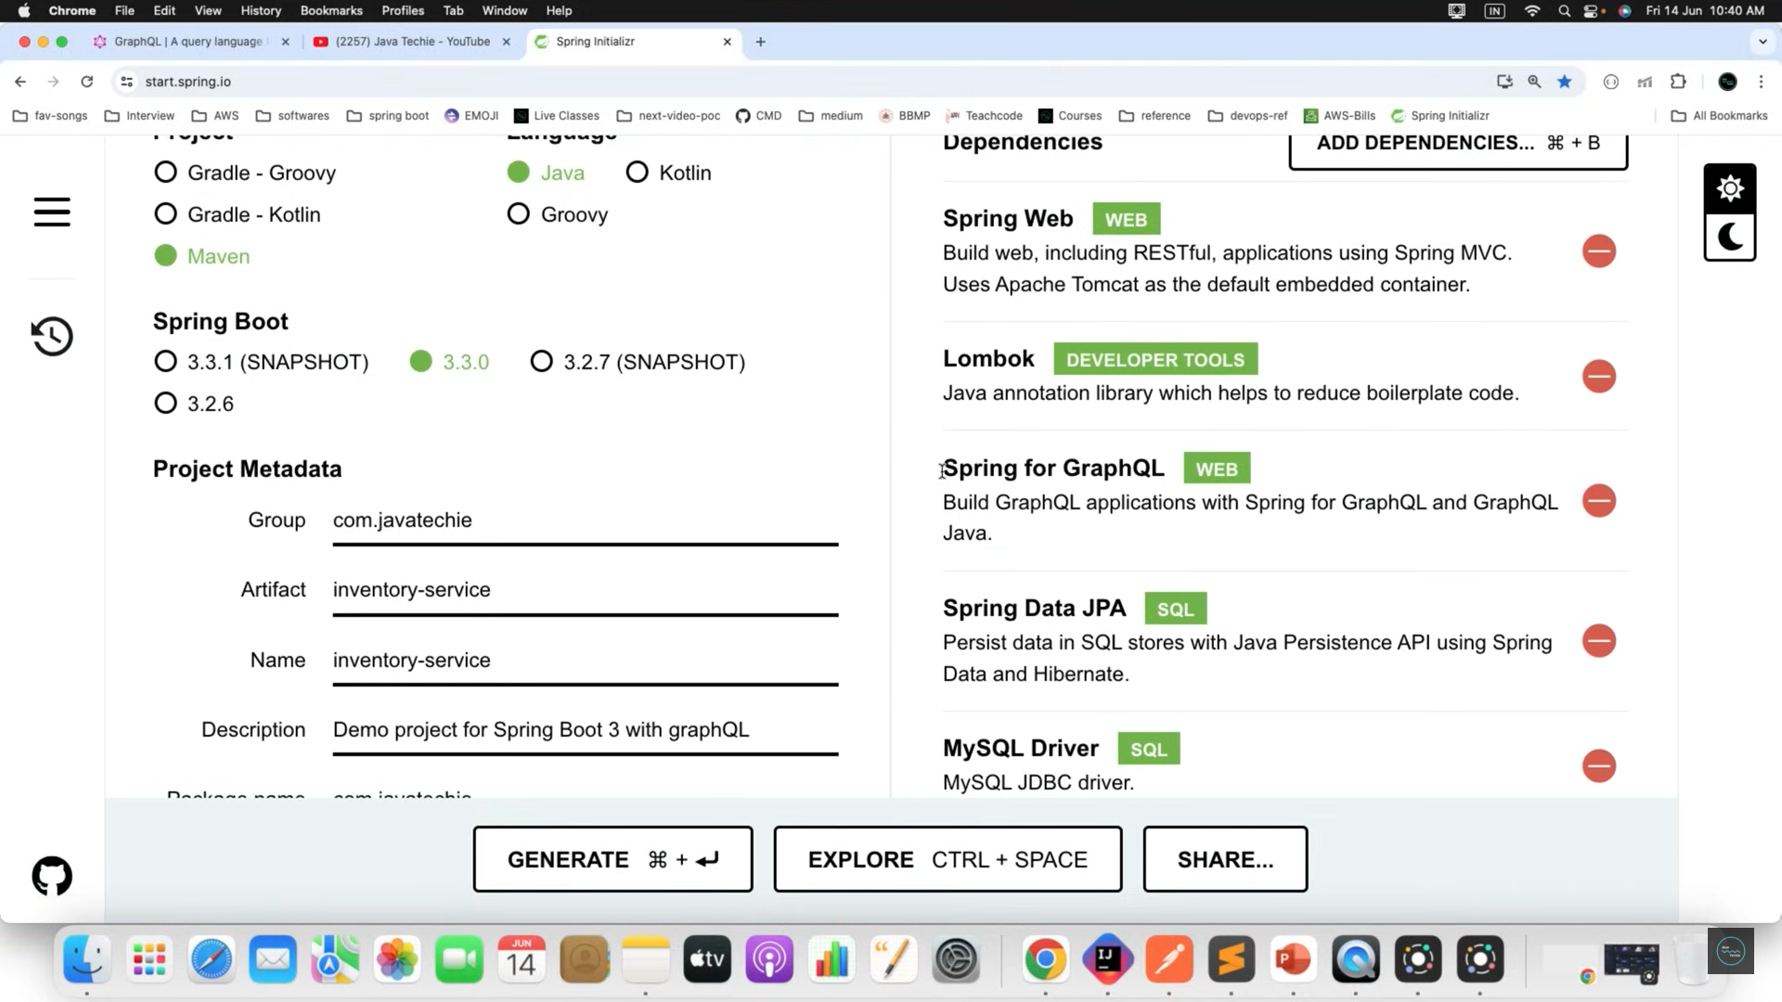
GraphQL

Slide 10
GraphQL
Queries
Mutation
Subscription

Slide 11
http://localhost:8080/graphql
REF:
https://graphql.org/learn/
https://www.geeksforgeeks.org/graphql-query/

Slide 12
Thank You

